Slide 2




DANGER

Slide 3




Slide 4
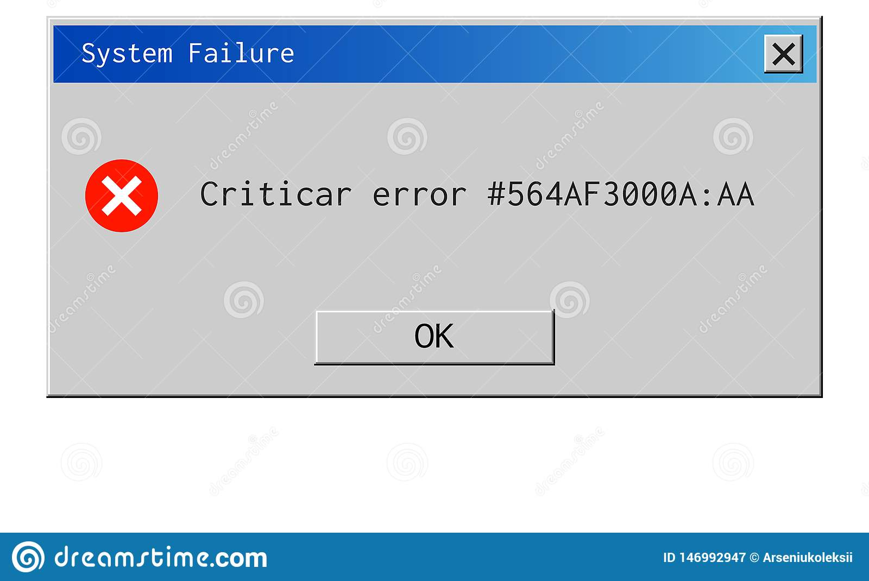


Ideas

Slide 5
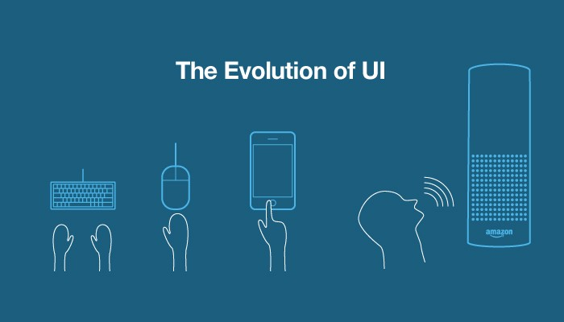
Goals
Less text
Direct
Intuitive
Voice UI (?)

